Slide 1

Wireless Parking Detection System
Senior CAPSTONE
Students(Group M5)
Yuecan Fan, Sining Liu,
Weining Zou, Xi Zhang, Mengfei Zhang
Advisor
Professor Masoud Salehi

Slide 2




CONTENTS
01
Introduction & Background
Information
02
Hardware Design
03
Software Design
04
Video Exhibition
05
Conclusion

Slide 3
WHAT IS THIS TALK ABOUT
Parking Problem:
Always have trouble in finding an available Parking position
Spend a high amount parking fee in a garage
Spend a lots of time to wait or hang around
。
WHAT WE WANT
Use Sensors to detect the available parking spot on the Street
Wireless upload parking data to Cloud Server
Visualize real-time street parking data on App & Let user Self-Report

Slide 4
INTRODUCTION
Implementation has two parts:
• Hardware Design (Sensor Detection System& Wireless Upload Data):
• Use Magnetic Sensor to detect car movement
• Use Arduino board to build circuits and print out data
• Use XBee, XBee gateway to upload data to the cloud
• Software Design (Data visualization on the Map & App Basic functions)
• Registration and Sign In System
• Get Real-Time Data & User Self Report

Slide 5
CONTENTS
02
Hardware Design

Slide 6
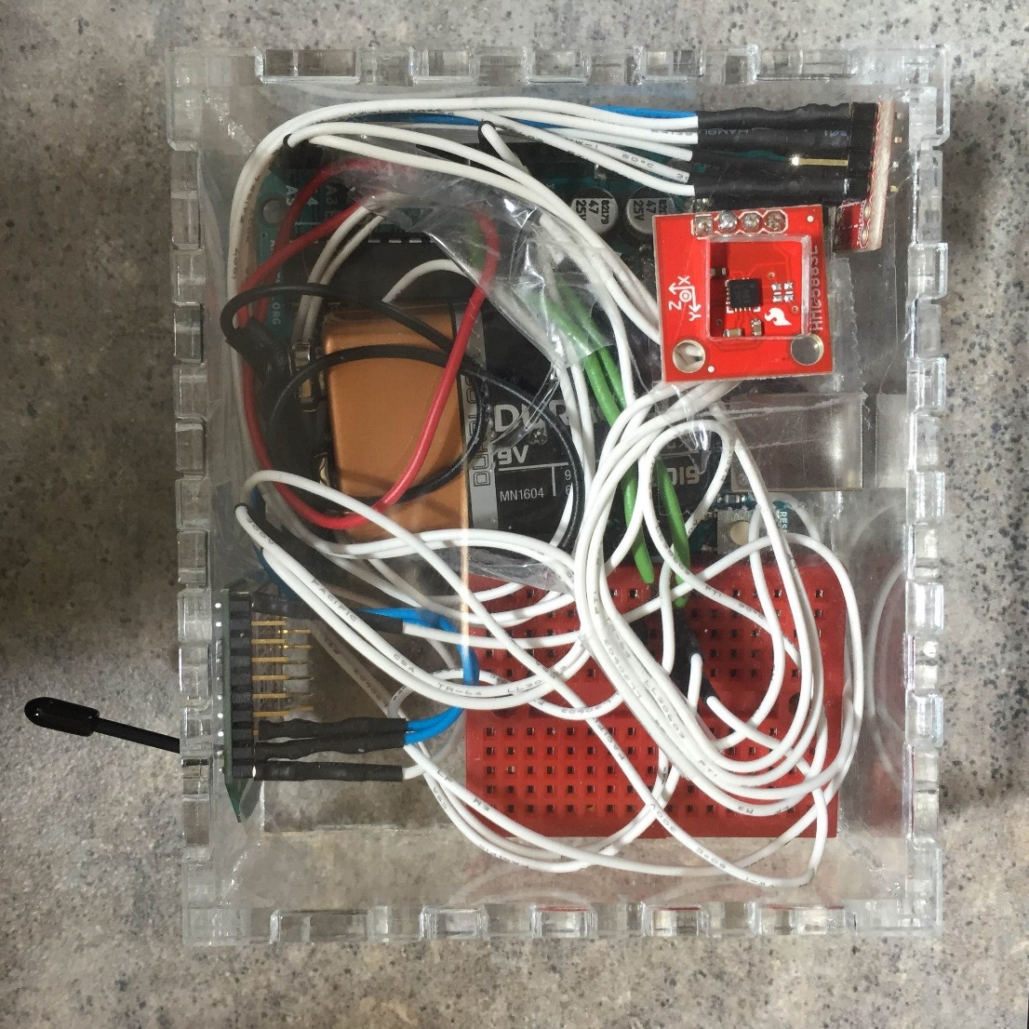
Sensor Node
Magnetic sensor
Arduino Uno
XBee
Logic level converter
Battery

Slide 7
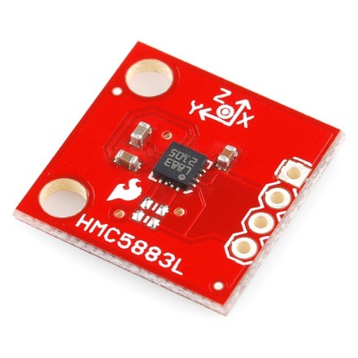
Magnetic Sensor
Hmc5883l
Usually Use to make compass
Can detect magnetic field change in three directions

Slide 8
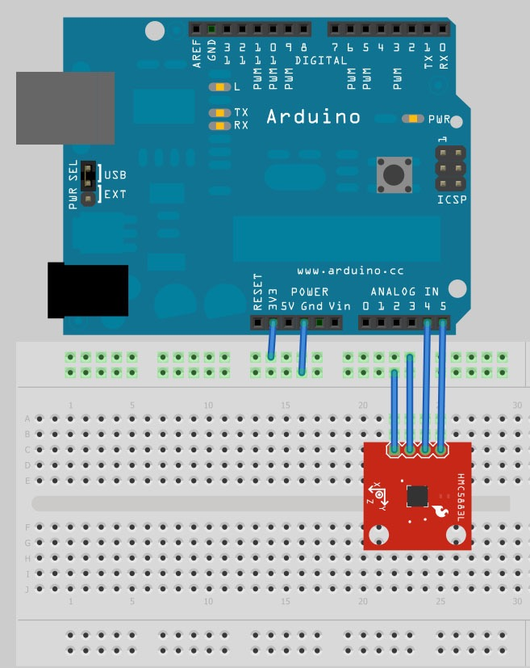
Microcontroller
Arduino Uno
Most common microcontroller and easy to use
Can easily connect to HMC5883L and XBee
Modify the code to detect the change of z axis magnetic field that shows “1” for occupied and “0” for available

Slide 9

Battery
Input Voltage for Arduino Uno is 7-12V
Duracell 9V battery

Slide 10
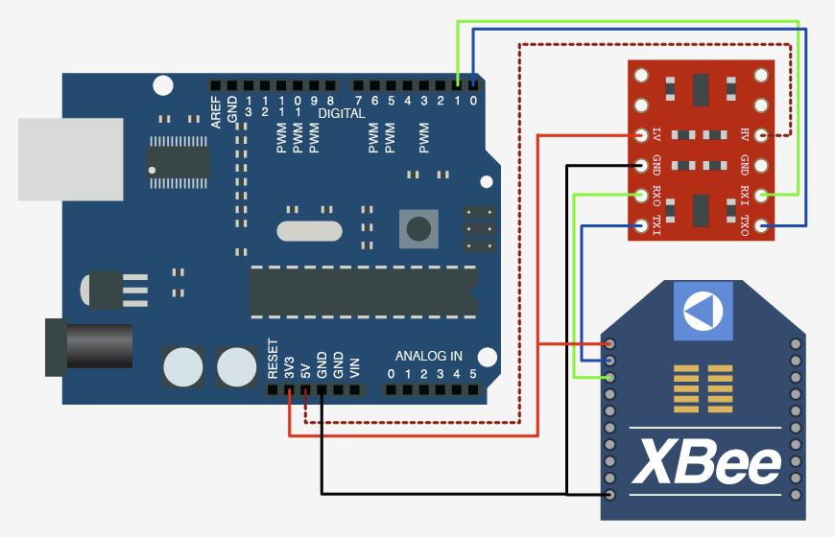
Logic level converter and XBee
XBee’s operating voltage is 3.3V
Arduino Uno communicate at 5v. Even if we use the 3.3v pin, the serial, digital pins, everything, are all still operating at 5v.
So we need to connect logic level converter to protect XBee form burning out.

Slide 11
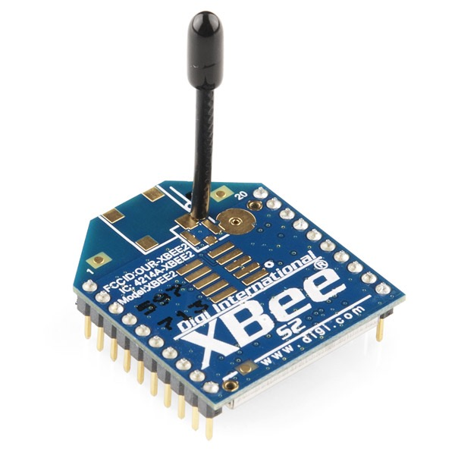

Local Data Transfer

Slide 12
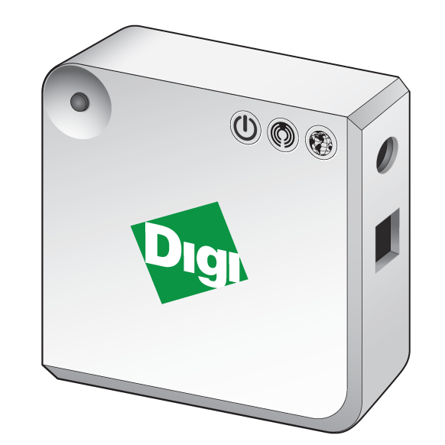
Online Data Transfer
Digi Device Cloud

Slide 13
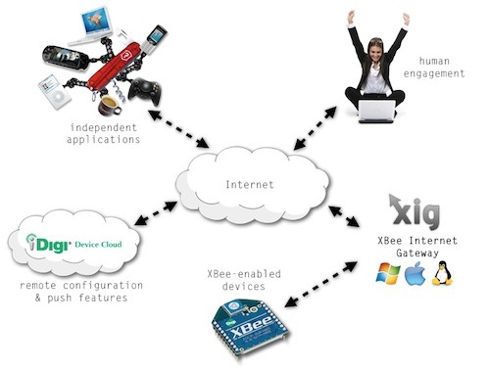

Slide 14
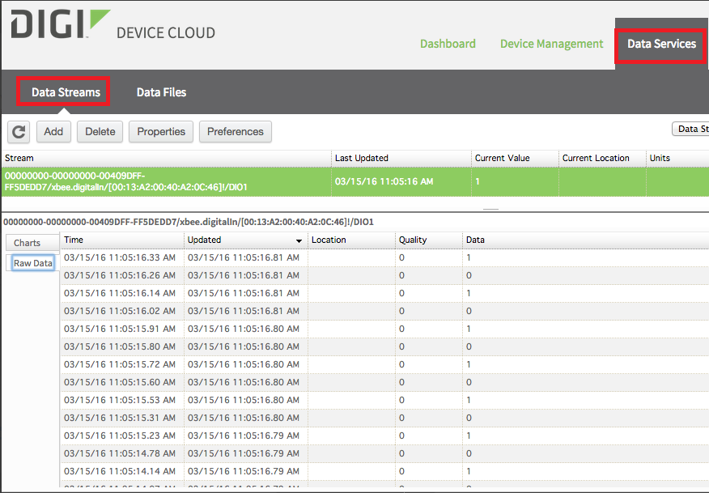
Online Data

Slide 15
CONTENTS
03
Software Design

Slide 16
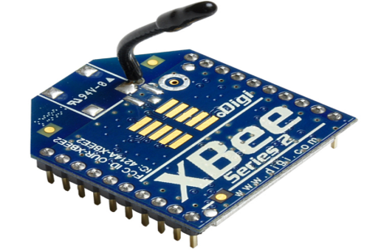

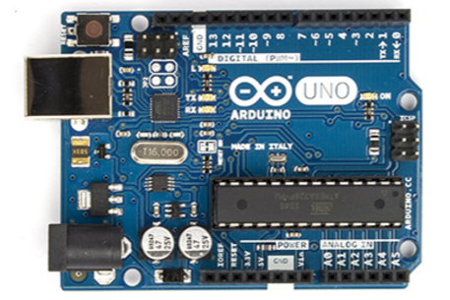
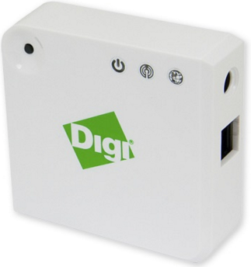


Coding on Hardware, Connection building & Storing
Write Python to build the connection with gateway, differentiate each XBee and upload the data with small delay
Program code on the ARUINO board to let Sensor print out two different status
Write Swift Code to synchronously get real-time data
Store User information

Slide 17
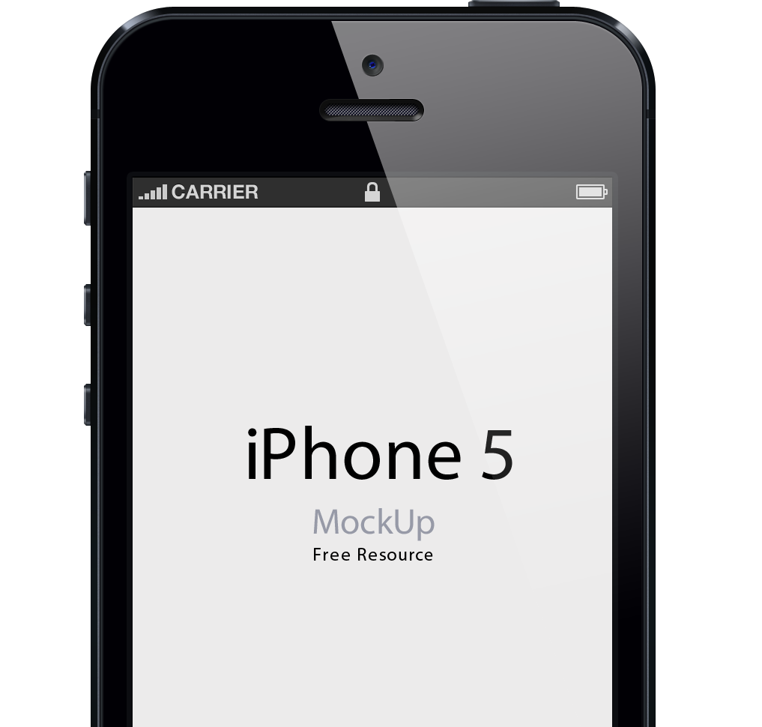

App Functions
The app will provide user available parking slots.
Map View
The nearby available street parking information will show on the map.
User Registration
User can register using their email address. They will get an email confirmation from our server.
User Self Report
Consider App may not include all parking information, this function design to let User Self Report.

Slide 18
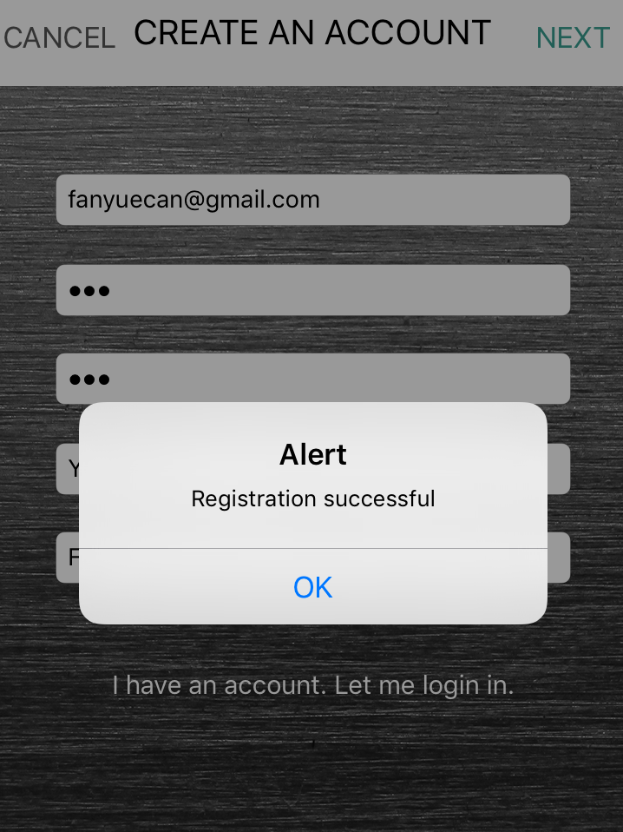
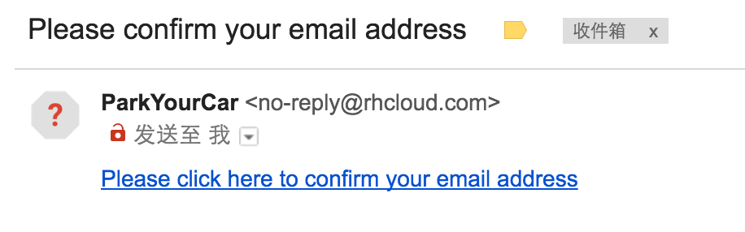
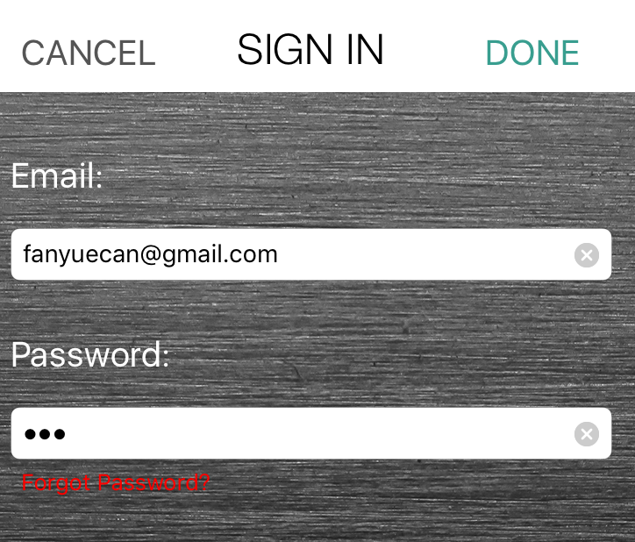

Registration, Sign In System
Registration
Sign In

Slide 19
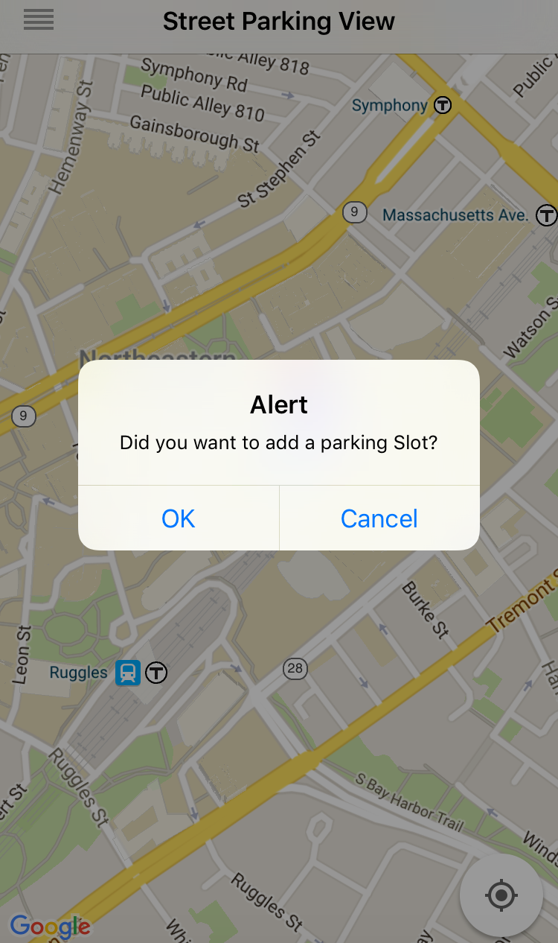
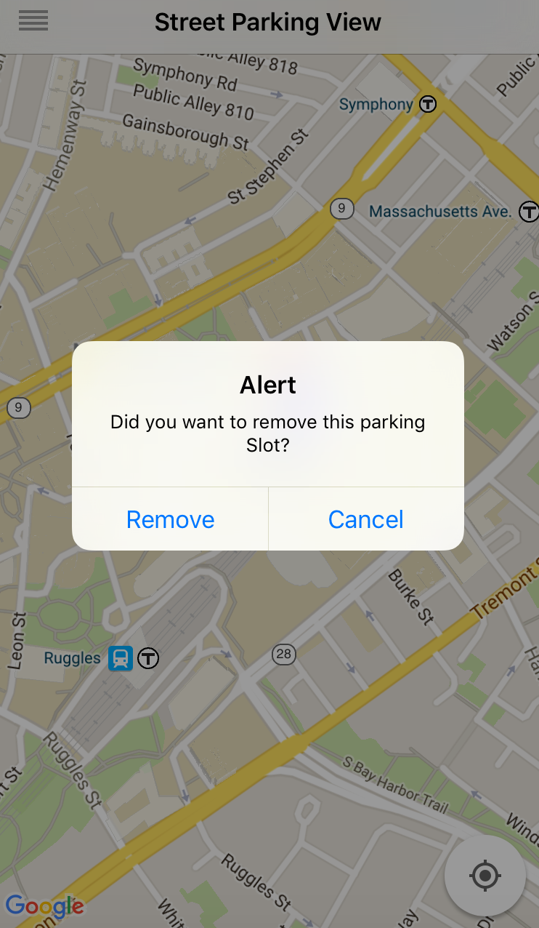
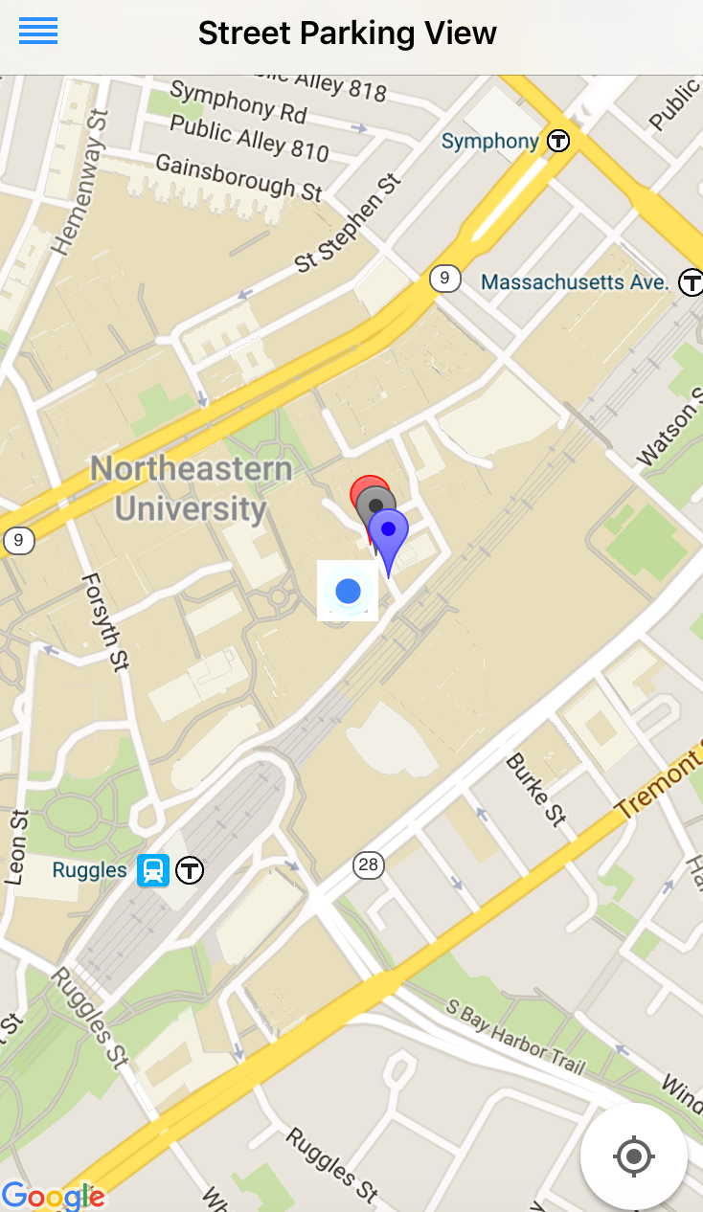
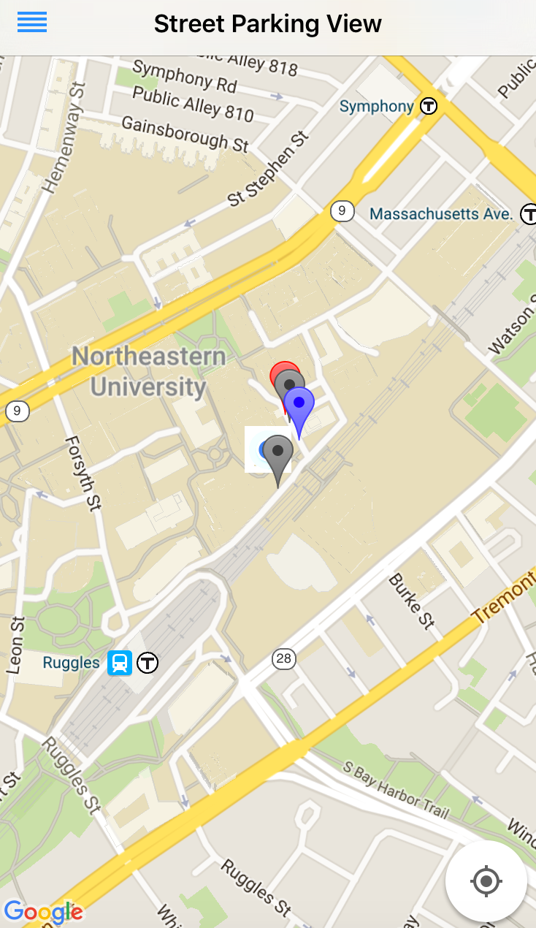
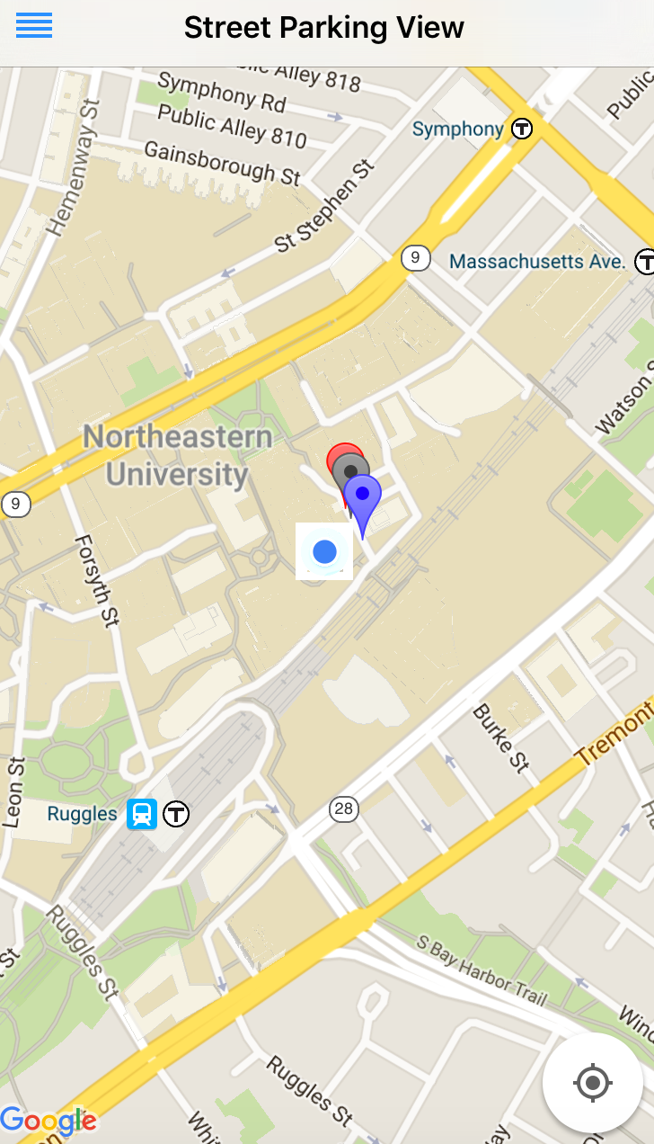
Map View

Slide 20
Implement the App
The app use Xcode to build and
support iOS devices only at this time.
Programming
Use Swift to build functions and Story Board in Xcode to simulate the app, use PHP file to connect app with online database
User Interface Design
Design icon and pictures in Photoshop, change default background and adjust the button location
Build-in Map
Use Google Map API to get user current location, and make real-time data showing

Slide 21
CONTENTS
04
Video Exhibition

Slide 22
CONTENTS
05
Conclusion

Slide 23
Conclusion
New Solution to Park Problem
Collect real-time data
Save time and money
。

Slide 24

Flaws and solutions
01
As the number of devices increases, the Network Construction become more complicated.
Sensor Network Design
02
Battery can only last for several days due to the XBee energy consumption.
Battery
Easier Registration System
Registration may require user fill too much Information
03
Garage Information collected
Garage parking information did not contain in our app
04

Slide 25
Solutions
Sensor Network Design
Battery
Add Sleep mode to XBee.
More XBee coordinators and Gateway added
Easier Registration System
Garage Information
Add Google account and Facebook account registration function
Collaborate with other Boston Parking website to get garage parking information

Slide 26
THANKS
Questions? Comments?

